Slide 1
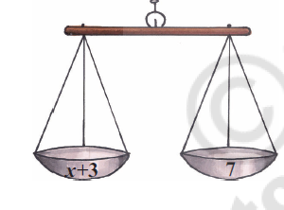
SIMPLE EQUATIONS
What is an Equation? An equation is a mathematical expression that has L.H.S (Left Hand Side) and R.H.S (Right Hand Side). It is written as LHS = RHS
3X + 5 = 20
EQUATION
RESET
VALUE OF X = INPUT BOX
 | LHS | RHS
 | 4 | 7
 | 5 | 7
 | 6 | 7
 | 7 | 7
 | 8 | 7
LHS
RHS

Slide 2
DESIGN.
SHOW THE EQUATION DESCRIPTION IN BIG FONT.
NEED AN INPUT BOX TO SHOW EQUATION. THIS VALUE CAN BE CHANGED RANDOMLY BY PROGRAMMER – RESET BUTTON
TABLE ON LEFT, TEACHER OR STUDENT CAN INPUT VALUE FOR X. THE LHS VALUE SHOULD CHANGE BASED ON THE VALUE OF X.
THE BALANCE SHOULD TILT TO RIGHT OR LEFT BASED ON THE VALUE OF LHS.
IT SHOULD BE IN PERFECT BALANCE WHEN LEFT HAND = RIGHT HAND. THAT ROW SHOULD BE HIGHLIGHTED IN GREEN ON THE TABLE
RESET BUTTON SHOULD CLEAR THE TABLE AND PUT A NEW EQUATION. FIRST ROW OF TABLE IS ALWAYS FILLED WITH X = 0
PROGRAMMER – USER KEEPS CHANGING VALUE OF X, FOR EVERY VALUE OF X, RECORD A ROW IN THE LHS RHS TABLE. THIS TABLE SHOULD HAVE THE ABILITY TO ACCOMMODATE MORE ROWS

